Slide 1
Agent Orange
By: Handsome Tuong Vo

Slide 2
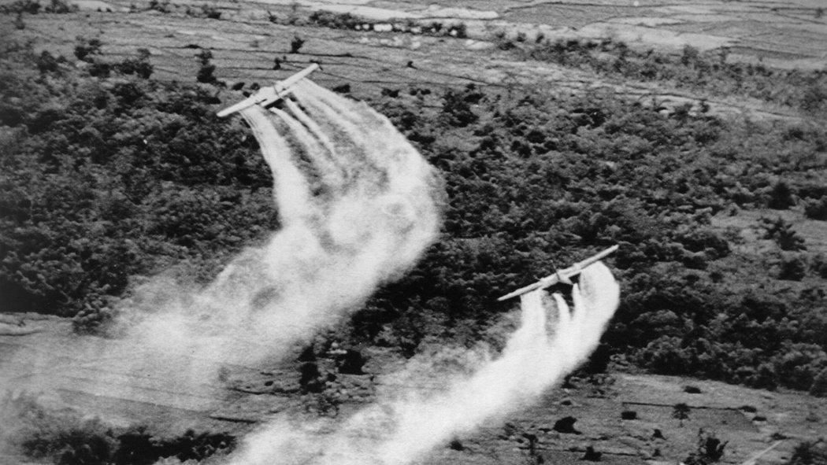

Slide 3
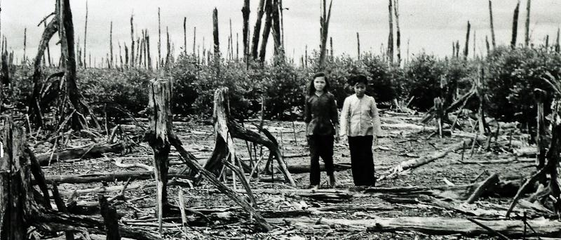

Slide 4
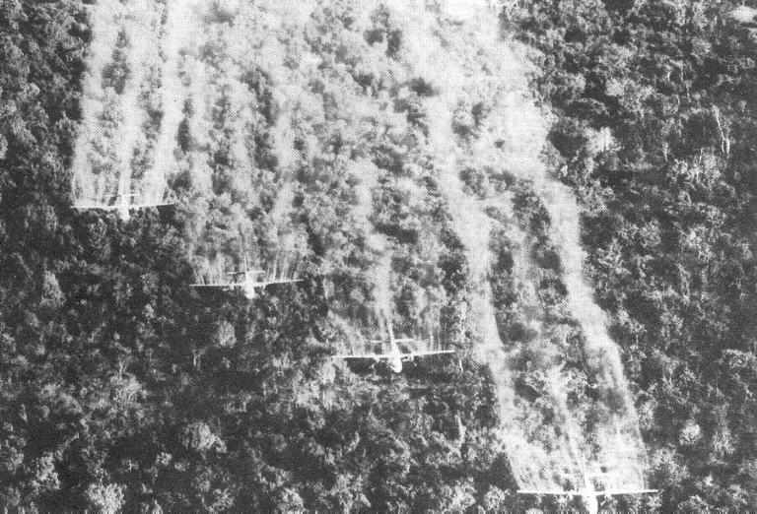

Slide 5
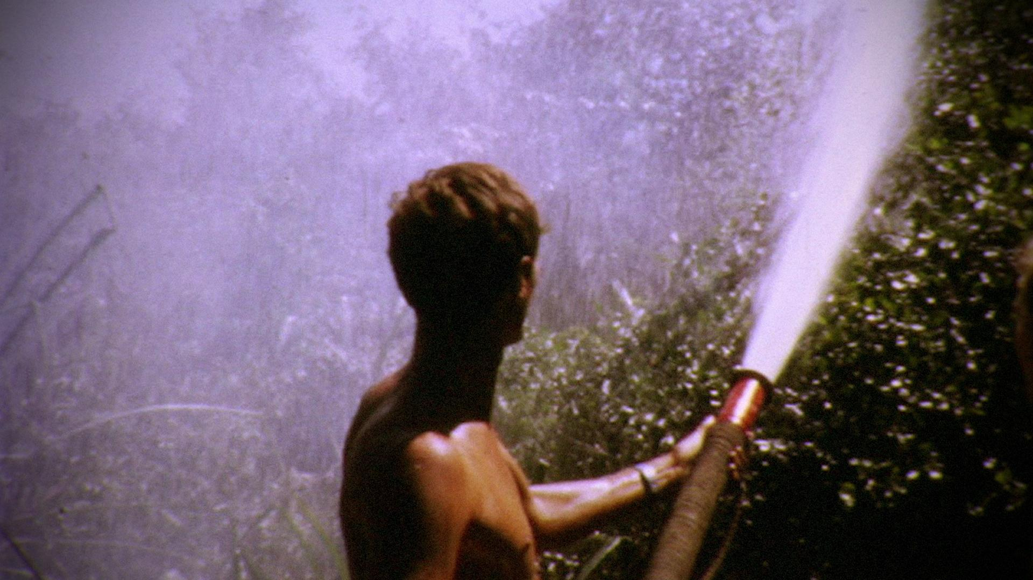

Slide 6
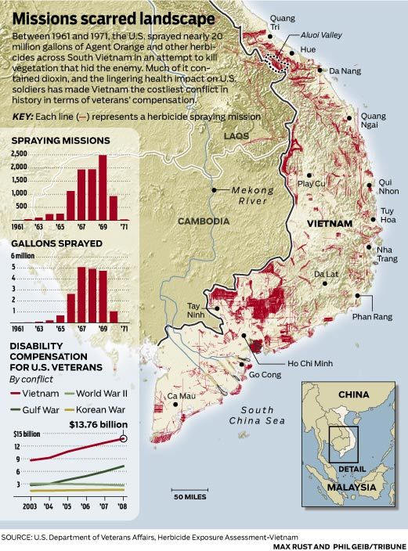

Slide 8
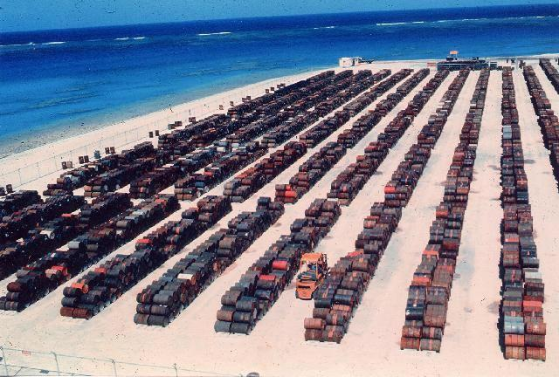

Slide 9
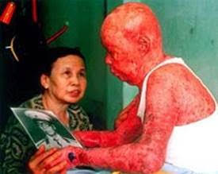

Slide 10
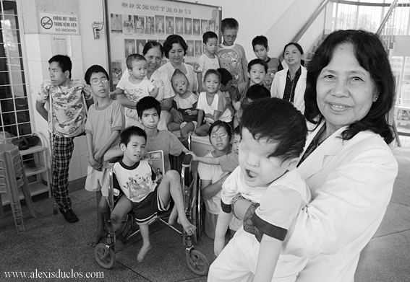

Slide 12
Credits
http://www.history.com/topics/vietnam-war/agent-orange (History Channel)
https://en.wikipedia.org/wiki/Agent_Orange (Wiki)
http://www.agentorangerecord.com/agent_orange_resources/news/
www.ejnet.org/dioxins/

